Slide 1
Paper Figures
Draft 1

Slide 2
Enotropy and Heatmap - Draft

Slide 3
Vincentiles and Effect - Draft

Slide 4
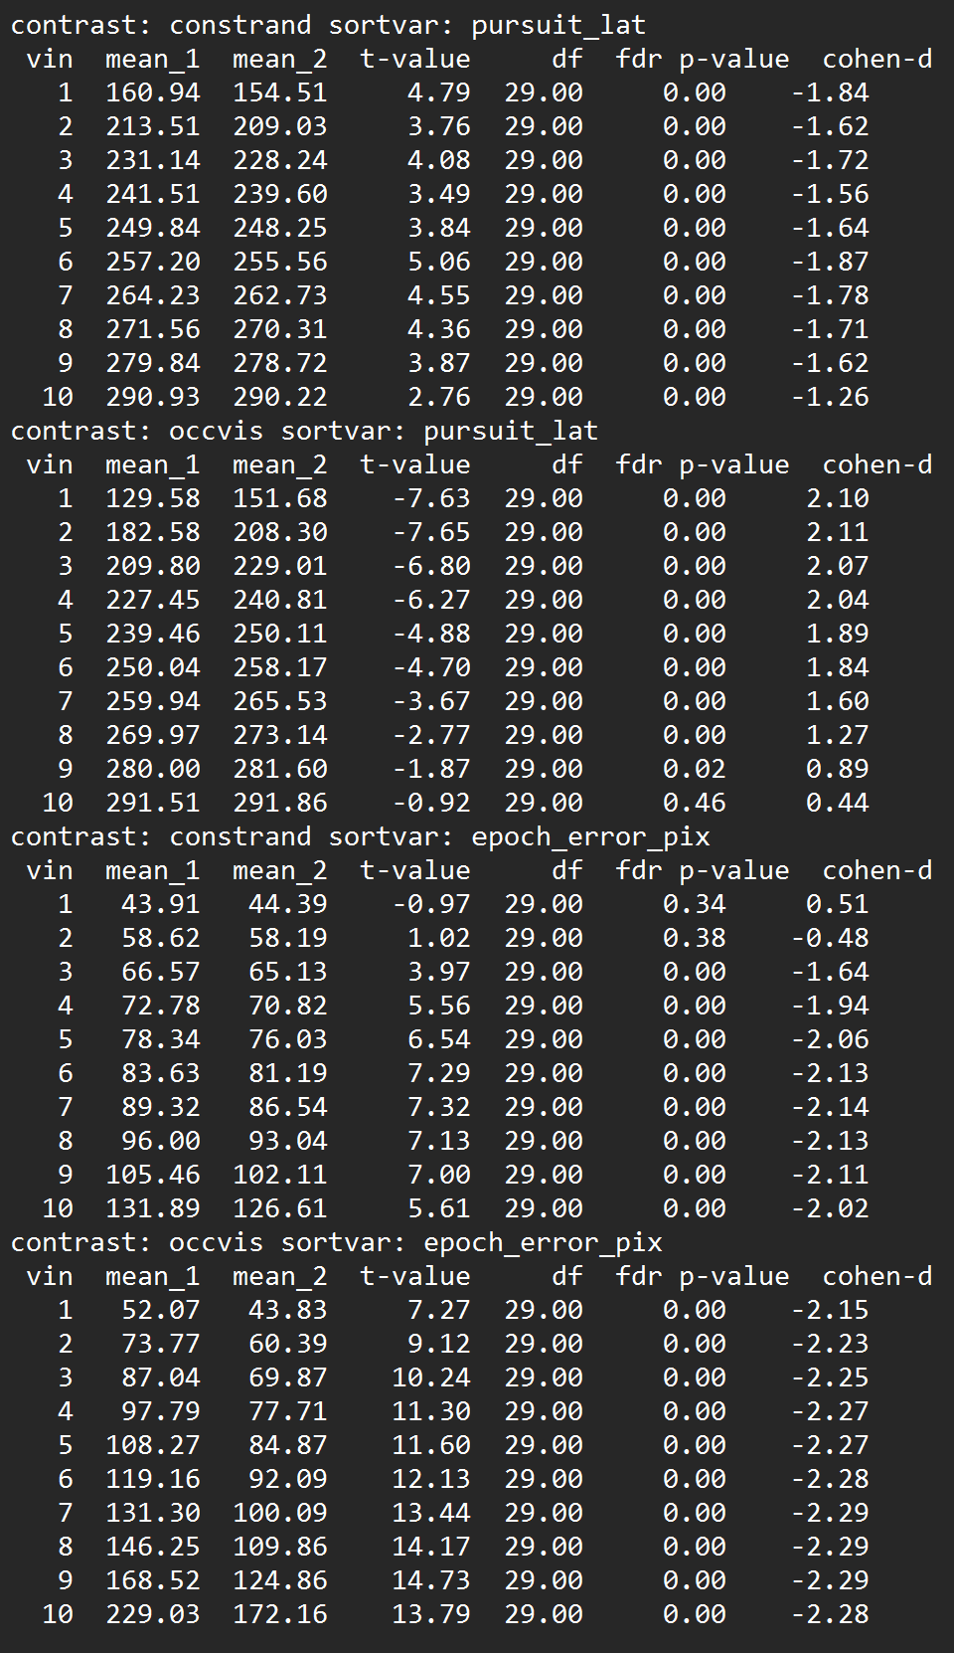
Entropy and Heatmap - Draft
How to report the test results?
Implement in graphic? Or table?

